Slide 1
StringBuilder – subSequence method
Method | Description
public CharSequence subSequence(int start, int end) | Returns a new character sequence that is a subsequence of this sequence.
StringBuilder sb = new StringBuilder("Welcome");
CharSequence charSequence = sb.subSequence(3, 6); = “com”
W | e | l | c | o | m | e
0
1
2
3
4
5
6
Starting Index
Ending Index

Slide 2
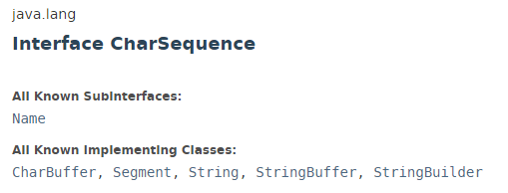
StringBuilder – subSequence method

Slide 3
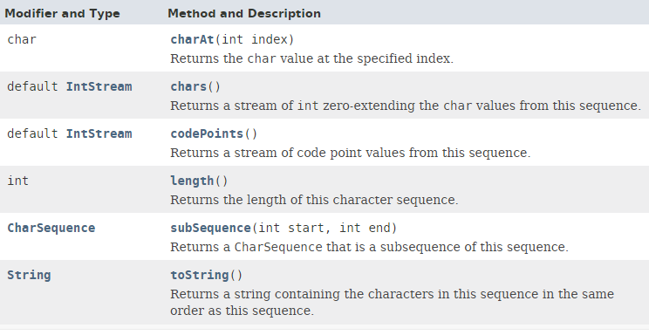
StringBuilder – subSequence method

Slide 4
StringBuilder – subSequence method
https://docs.oracle.com/javase/8/docs/api/index.html?java/lang/CharSequence.html

